Slide 1

Chapter 2
Network Models
School of Computer Science and Engineering
Pusan National University
Jeong Goo Kim

Slide 2
Ch. 2: Outline
2.1 Protocol Layering
2.2 TCP/IP Protocol Suite
2.3 OSI Model

Slide 3
    Ch. 2 : Objective
    Objective
Discuss the two network protocols: TCP/IP and OSI model
The first section introduces the concept of protocol layering using two scenarios:
  Single layer
  Multi-layer
The second section discusses the five layers of the TCP/IP protocol suite.
The third section gives a brief discussion of the OSI model.

Slide 4
    2-1 Protocol Layering
    2-1 Protocol Layering
In data communication and networking, a protocol defines the rules that both the sender and receiver and all intermediate devices need to follow to be able to communicate effectively.
When communication is simple, we may need only one simple protocol.
When the communication is complex, we may need to divide the task between different layers, in which case we need a protocol at each layer, or protocol layering.

Slide 5
    2.1.1 Scenarios
    2.1.1 Scenarios
Let us develop two simple scenarios to better understand the need for protocol layering.
In the first scenario, communication is so simple that it can occur in only one layer.
In the second, the communication between Maria and Ann takes place in three layers.

Slide 6
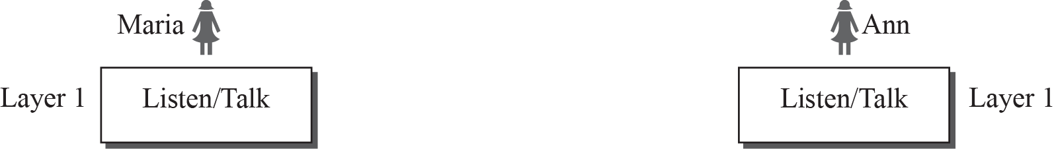
    2.1.1 Scenarios
    Fig. 2.1 A single-layer protocol

Slide 7
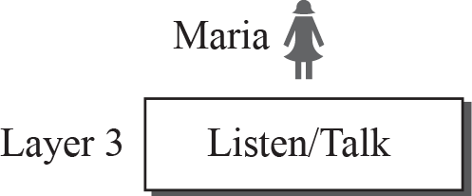
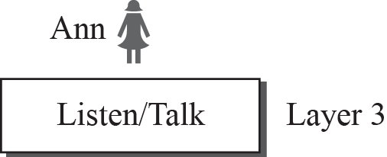


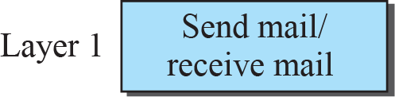
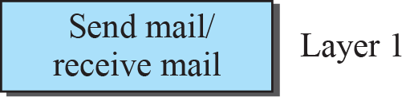
    2.1.1 Scenarios
    Fig. 2.2 A Three-layer protocol

Slide 8
    2.1.2 Principles of Protocol Layering
    2.1.2 Principles of Protocol Layering
Let us discuss two principles of protocol layering.
The first principle dictates that if we want bidirectional communication, we need to make each layer so that it is able to perform two opposite tasks, one in each direction.
The second principle that we need to follow in protocol layering is that the two objects under each layer at both sites should be identical.

Slide 9
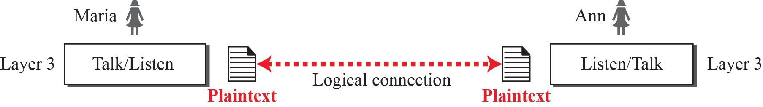
    2.1.3 Logical Connections
    2.1.3 Logical Connections
Layer-to-layer communication.
    Fig. 2.3 Logical connection between peer layers

Slide 10
    2-2 TCP/IP Protocol Suite
    2-2 TCP/IP Protocol Suite
TCP/IP : Transmission Control Protocol/Internet Protocol
TCP/IP is a protocol suite (a set of protocols organized in different layers) used in the Internet today.
It is a hierarchical protocol made up of interactive modules, each of which provides a specific functionality.
The original TCP/IP protocol suite was defined as four software layers built upon the hardware. Today, however, TCP/IP is thought of as a five-layer model.

Slide 11
    2-2 TCP/IP Protocol Suite
    Fig. 2.4 Layers in the ICP/IP protocol suite

Slide 12
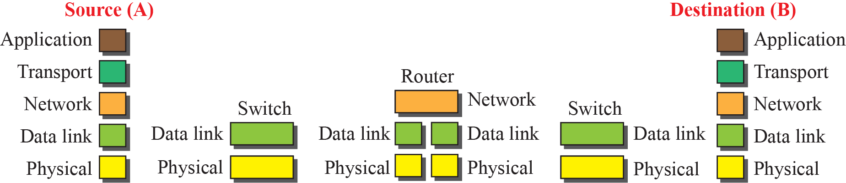
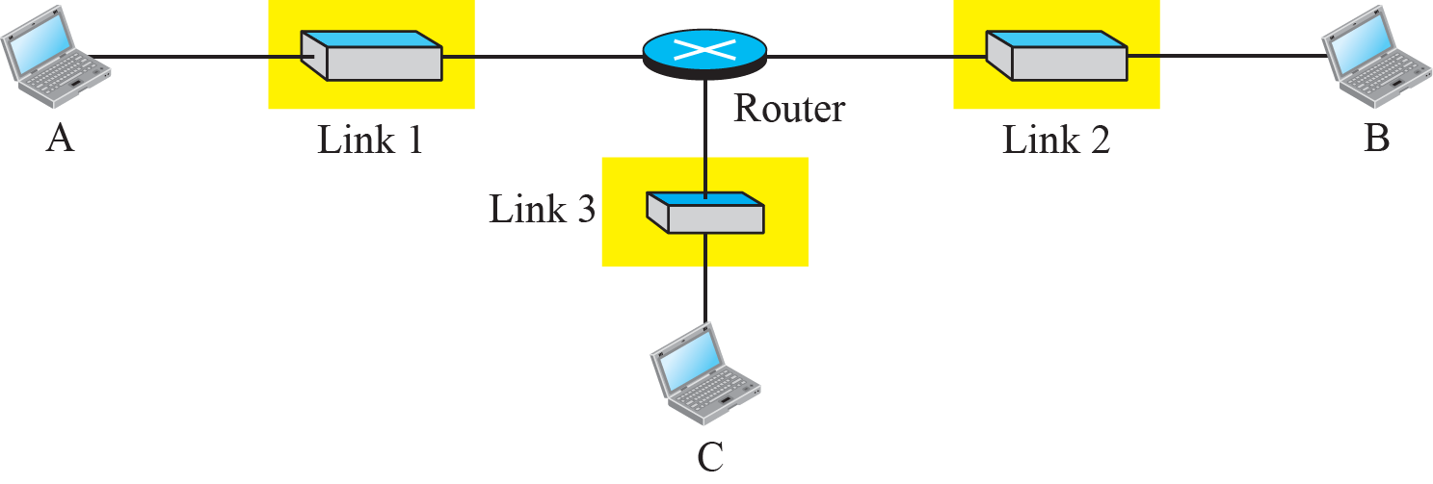
2.2.1 Layered Architecture
Fig. 2.5 Communication through an internet

Slide 13
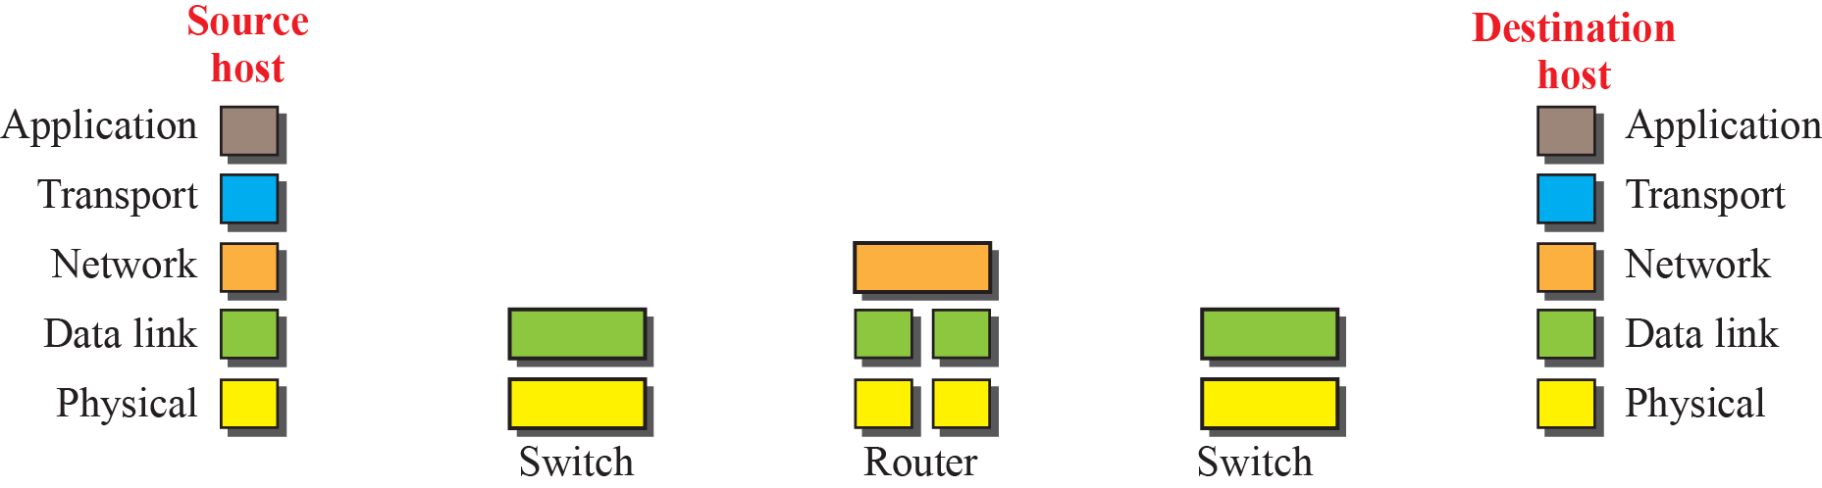
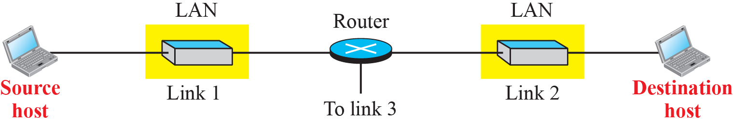
2.2.2 Layered in the TCP/IP Protocol Suite
Fig. 2.6 Logical connections between layers in TCP/IP
Logical connections

Slide 14
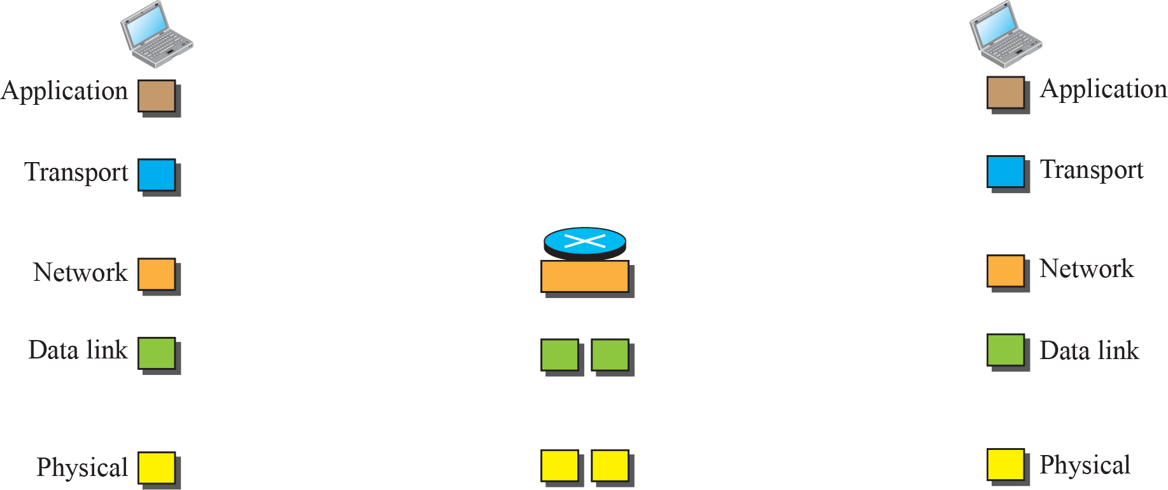
2.2.2 Layered in the TCP/IP Protocol Suite
Fig. 2.7 Identical objects in the in TCP/IP protocol suite
Identical objects (messages)
Identical objects (segment or user datagram)
Identical objects (datagram)
Identical objects (datagram)
Identical objects (frame)
Identical objects (frame)
Identical objects (bits)
Identical objects (bits)

Slide 15
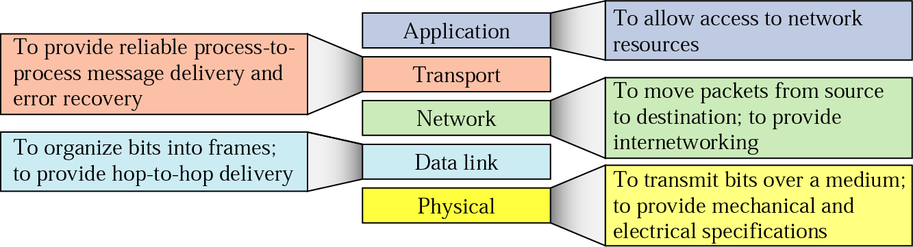
2.2.3 Description of Each Layer
2.2.3 Description of Each Layer

Slide 16
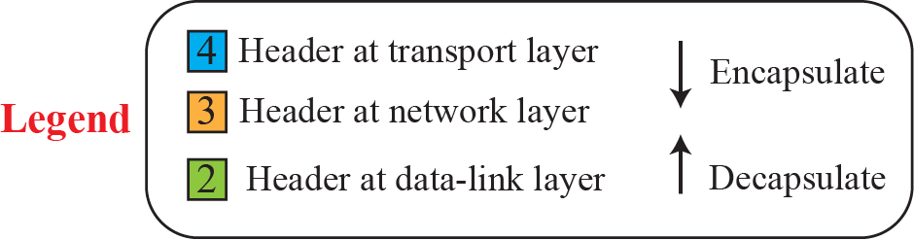
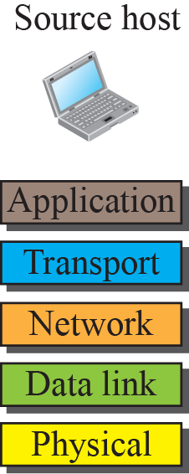
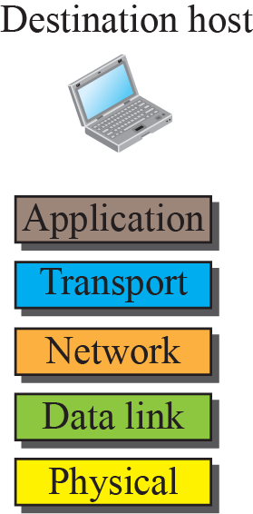
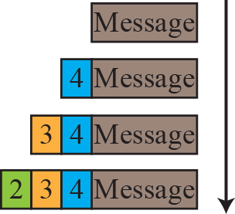
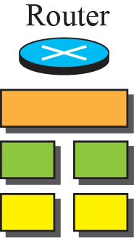
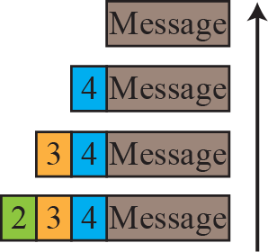
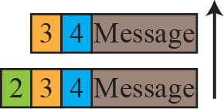
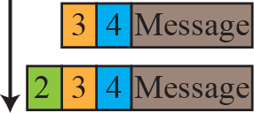
2.2.4 Encapsulation and Decapsulation
2.2.4 Encapsulation and Decapsulation
Fig. 2.8 Encapsulation and Decapsulation

Slide 17


2.2.5 Addressing
2.2.5 Addressing
Fig. 2.9 Addressing in the TCP/IP protocol suite

Slide 18
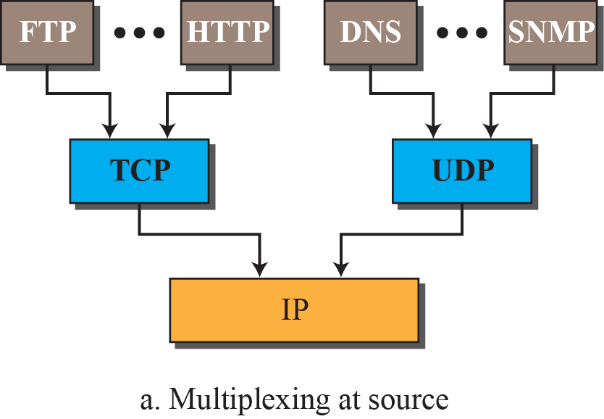
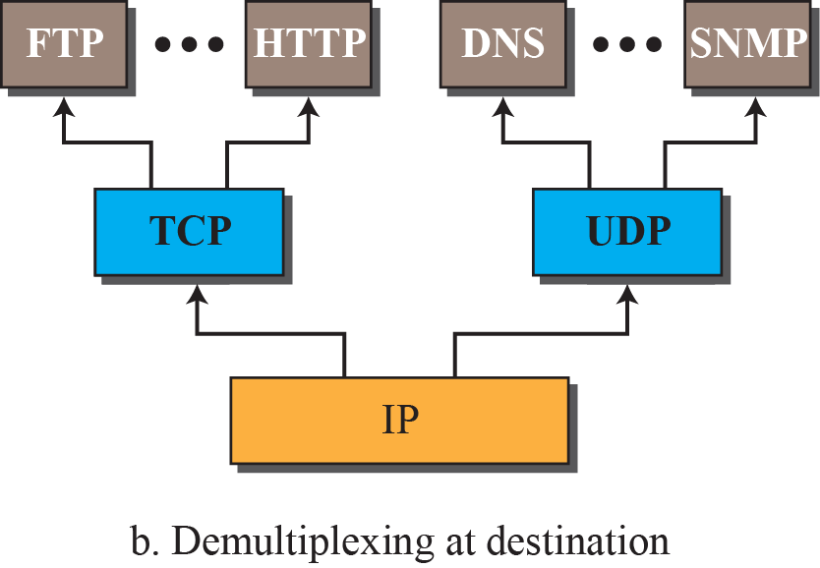
2.2.6 Multiplexing and Demultiplexing
2.2.6 Multiplexing and Demultiplexing
Fig. 2.10 Multiplexing and Demultiplexing

Slide 19
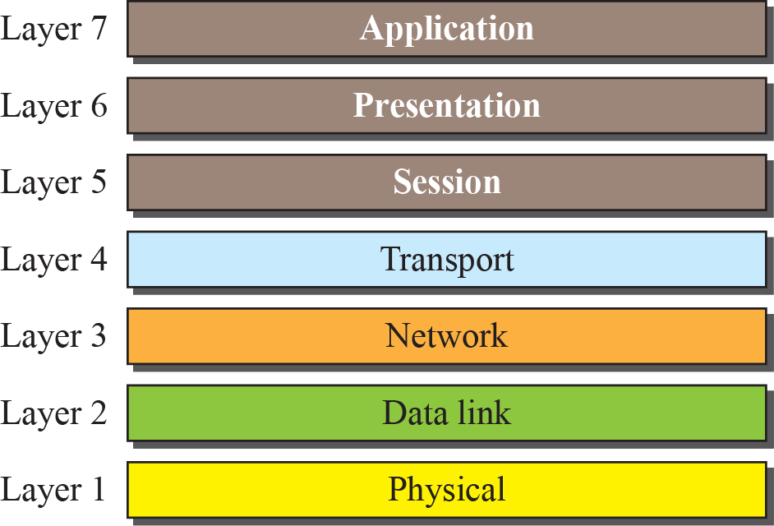
    2-3 OSI Model
2-3 OSI Model
International Organization for Standardization (ISO) is a multinational body dedicated to worldwide agreement on international standard
An ISO standard that covers all aspects of network communication is the Open Systems Interconnection (OSI) model.

Slide 20
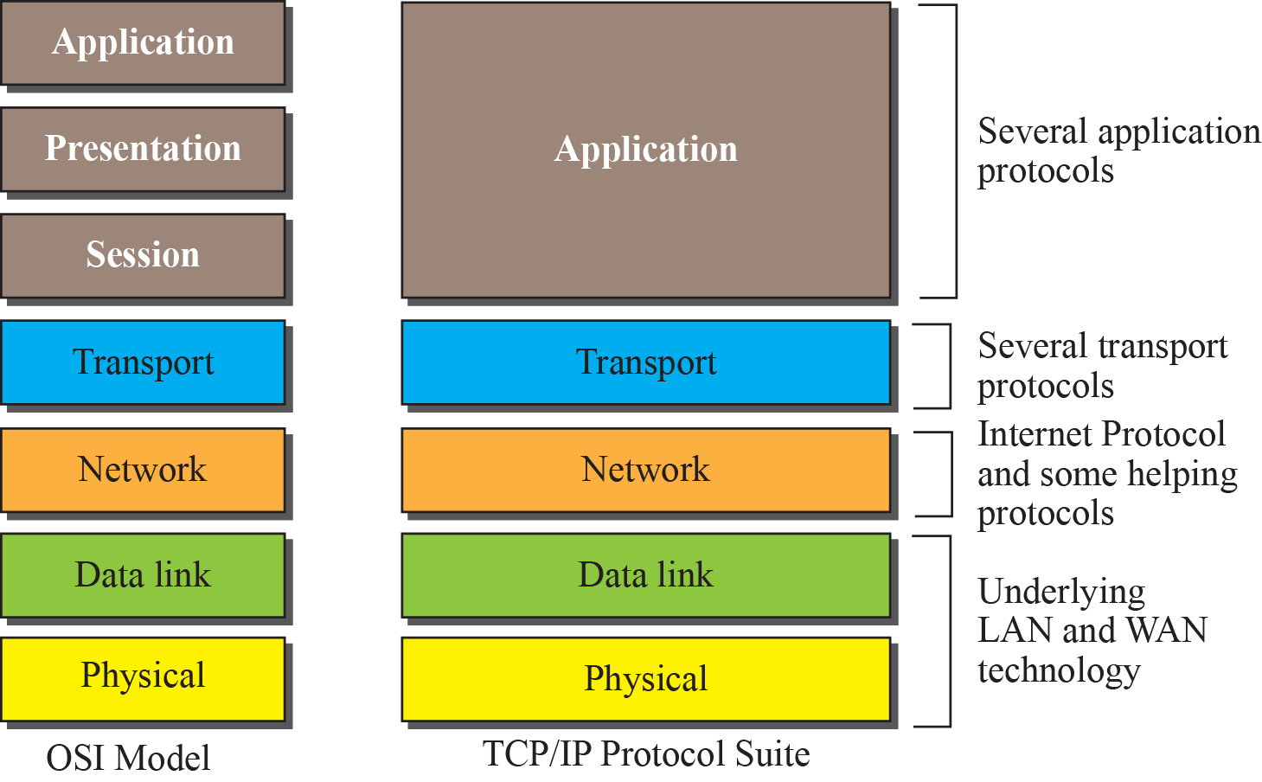
    2-3 OSI Model
    Fig. 2.12 TCP/IP and OSI model

Slide 21
2.2.3 Description of Each Layer
2.3.2 Lack of OSI Model’s Success
The OSI model appeared after the TCP/IP protocol suite. Most experts were at first excited and thought that the TCP/IP protocol would be fully replaced by the OSI model. This did not happen for several reasons, but we describe only three, which are agreed upon by all experts in the field.
  Changing it cost a lot.
  Some layers in the OSI model were never fully defined
  OSI did not show a high enough level of performance

Slide 22
Homework
Homework
Read textbook pp. 53-90
Next Lecture
Chapter 3. Introduction to Physical Layer

